Slide 1

Contactless Fare Payment Review
Hannah DeBruin
Weekly Meeting: Transit Data Subgroup
10/12/22

Slide 2
Open Loop Contactless Fare Payment
Chicago and Salt Lake City before the pandemic, but had low rates of adoption
December 2020 NYC started entirely contactless pay, with Apple Pay, Google Pay, contactless bank cards, or special-purpose OMNY cards. Tap-to-pay increased 225% since the start of 2021 (MTA data July 2021)
In 2019 Dayton, Ohio installed validators that charged riders via the Transit app
Portland, Oregon was the first to use Google Pay, and has used Apple Pay since 2019
Weekly Meeting (10/03/2022)
Hannah DeBruin

Slide 3
Contactless Payment Generally Since Pandemic
April 2020 Mastercard global (19 countries) consumer study:
80% use contactless payment
82% view contactless as the cleaner way to pay
Contactless payments 10 times faster than other in-person payment methods
52% of respondents under 35 years old use contactless-enabled cards
74% will continue to use contactless post-pandemic
40% growth in total # contactless transactions in first quarter of 2020
80% of contactless transactions are under $25 (could replace cash purchases)
Weekly Meeting (10/03/2022)
Hannah DeBruin

Slide 4
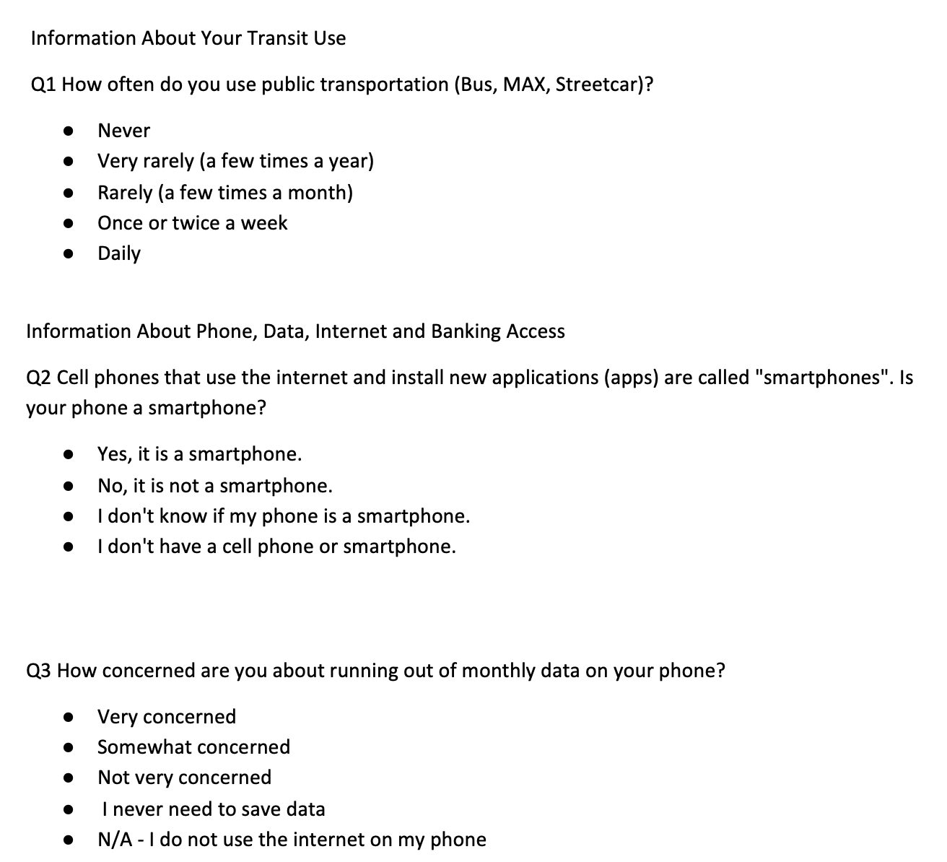
Survey Distribution
Target existing riders v potential riders?
On-board paper surveys v web/mail surveys
Paper surveys v digital surveys
Data synthesis easier with a digital format, but is it accessible/intuitive to all?
Want to minimize response bias
Weekly Meeting (10/03/2022)
Hannah DeBruin

Slide 5
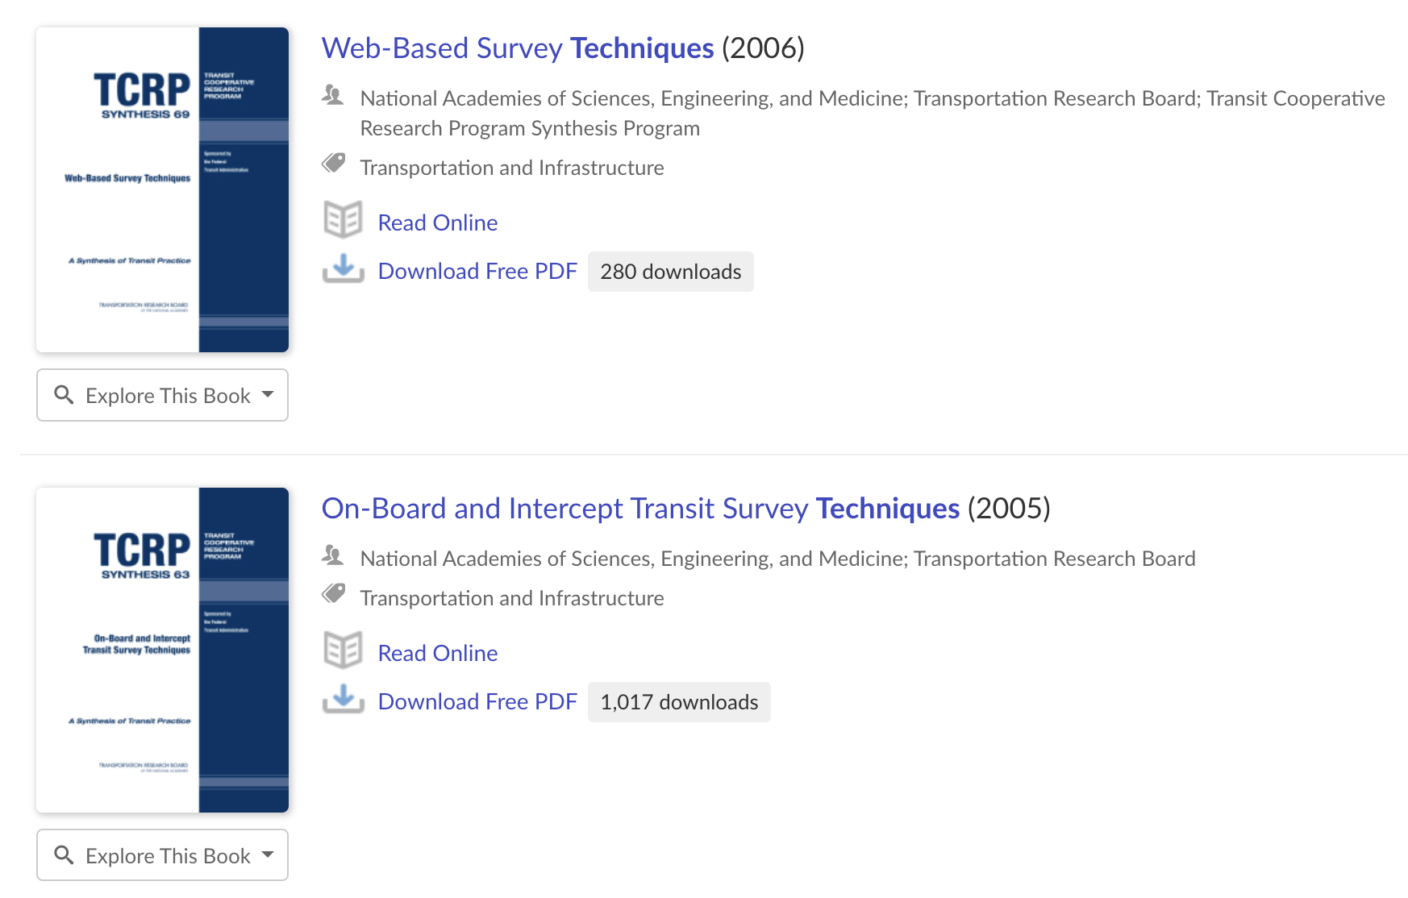
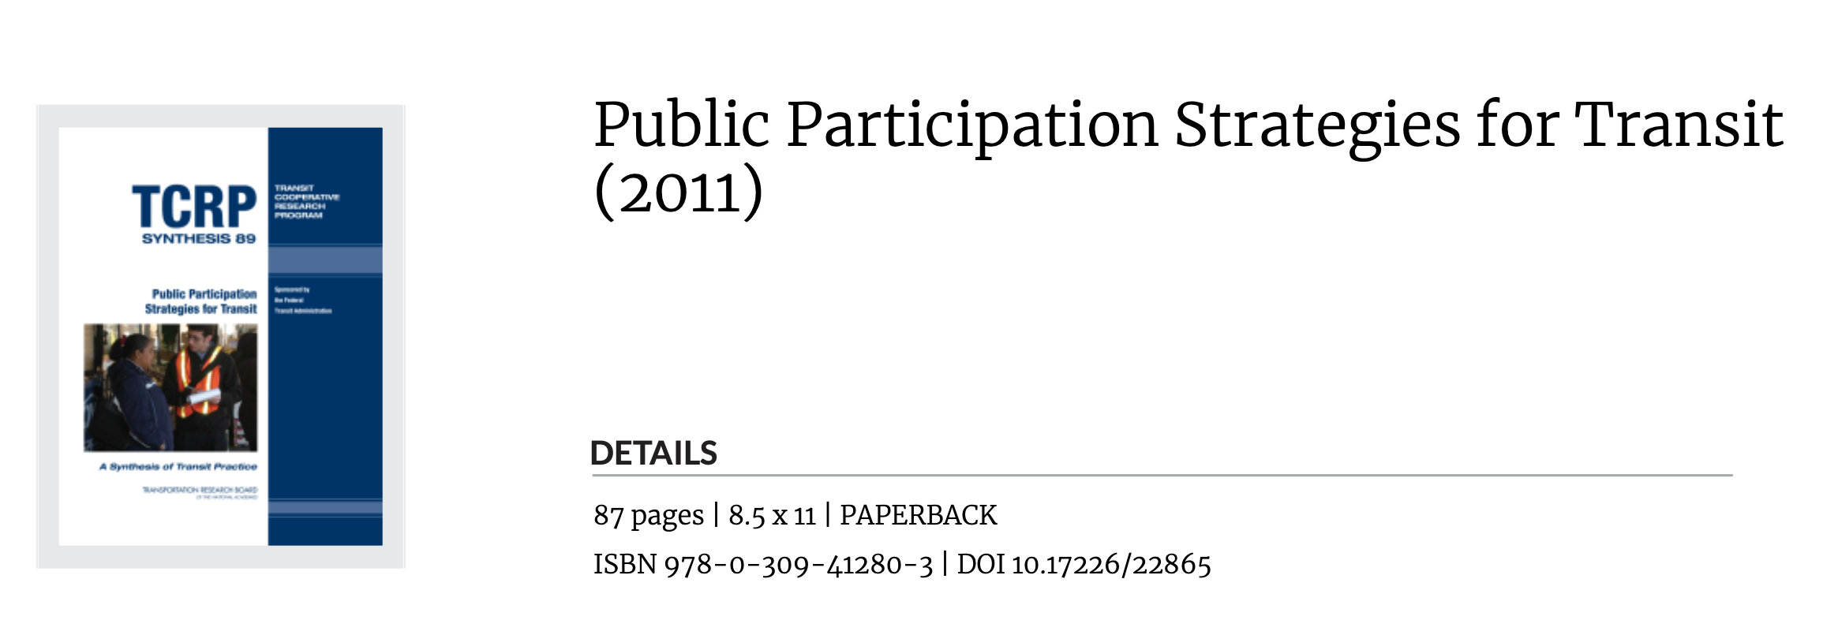
Will Continue Reviewing for Survey Distribution Choices
Weekly Meeting (10/03/2022)
Hannah DeBruin

